Slide 1
Knowledge graphs

Slide 2
Overview
Recap
Knowledge graphs
Knowledge graph completion

Slide 3
Recap

Slide 4
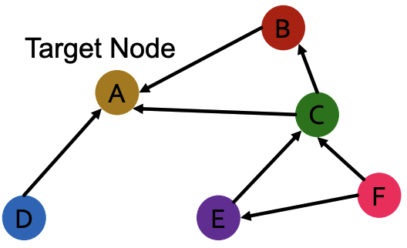
Heterogeneous graphs
Multiple node and / or edge types yielding multiple relation types
Image credit: Jure Leskovec, http://cs224w.stanford.edu

Slide 5
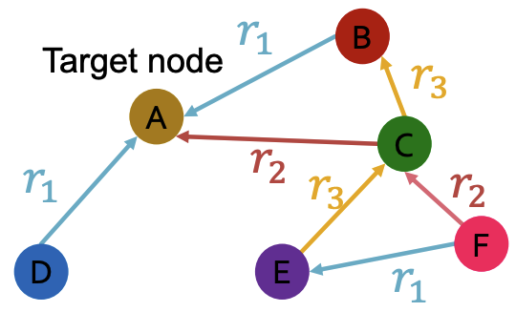
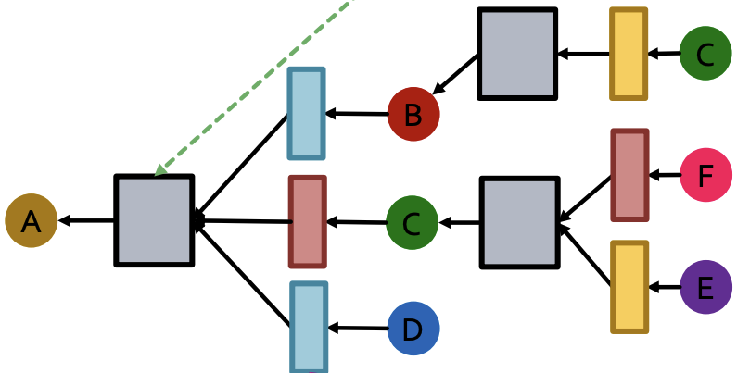
Relational graph convolutional networks (RGCN)
Extend GCN to handle heterogeneous graphs with multiple relation types
Different neural networks for different relation types
Aggregation
Distinct neural network for each relation type
Image credit: Jure Leskovec, http://cs224w.stanford.edu

Slide 6
Knowledge graphs

Slide 7
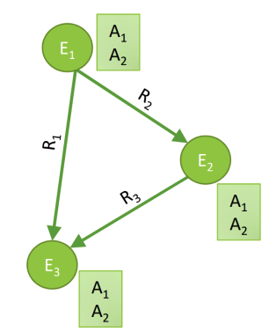
Knowledge graphs
Heterogeneous graphs that represent entities, types, and relationships
Nodes are entities
Nodes are labeled with their types
Edges between nodes indicate specific relationships between entities, often directional
Image credit: Jure Leskovec, http://cs224w.stanford.edu

Slide 8
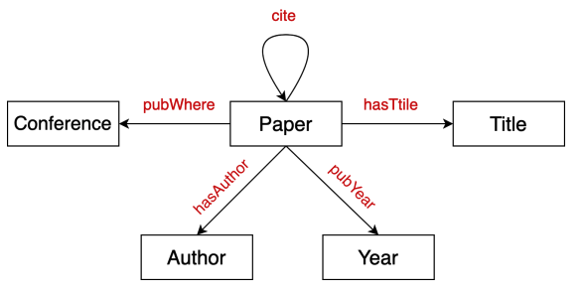
Bibliographic networks
Node types: paper, title, author, conference, year
Relation types: pubWhere, pubYear, hasTitle, hasAuthor, cite
Image credit: Jure Leskovec, http://cs224w.stanford.edu

Slide 9
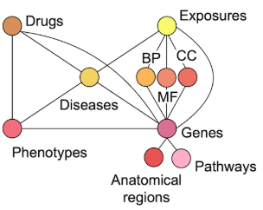
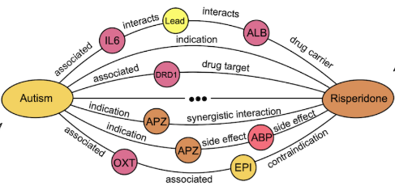
Biomedical knowledge graphs
Node types: drugs, biological pathways, diseases, …
Relation types: associated, interacts, …

Slide 10
More knowledge graphs
Google knowledge graph - https://developers.google.com/knowledge-graph
Amazon product graph
Facebook graph API - https://developers.facebook.com/docs/graph-api/
Microsoft graph - https://learn.microsoft.com/en-us/graph/overview
LinkedIn knowledge graph

Slide 11
Publicly available knowledge graphs
Wikidata - https://www.wikidata.org/wiki/Wikidata:Main_Page
Dbpedia - https://www.dbpedia.org/resources/knowledge-graphs/
YAGO - https://yago-knowledge.org/
NELL - http://rtw.ml.cmu.edu/rtw/kbbrowser/

Slide 12

Applications of knowledge graphs
Serving information
Augmenting LLMs (we’ll come back to this in a future lecture)

Slide 13
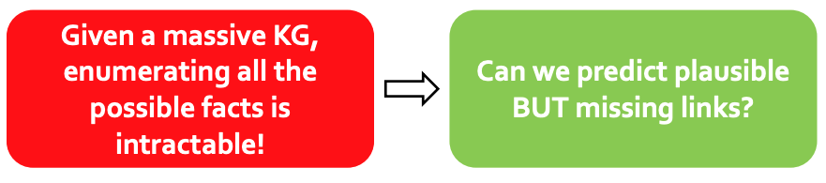
Common characteristics of modern knowledge graphs
Massive: Millions (or Billions) of nodes and edges
Even scientific knowledge graphs have up to hundreds of thousands of nodes and edges
Incomplete: Many true edges are missing (missing knowledge)
Image credit: Jure Leskovec, http://cs224w.stanford.edu

Slide 14
Knowledge graph completion

Slide 15
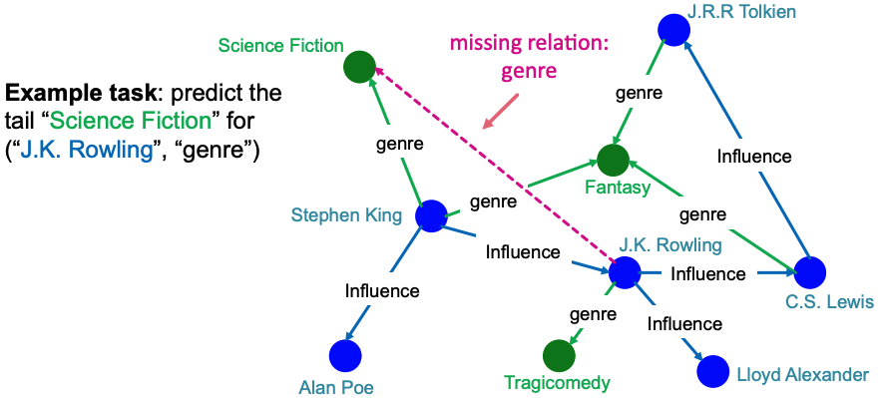
Knowledge graph (KG) completion task
Given a large KG, can we ”complete” it (i.e., add missing edges)
Task is typically formulated as predicting tails (or consequents)
Consider relations in a directed KG represented as a tuple (head, relation, tail) where head (h) has relation (r) with tail (t)
Given (head, relation) predict missing tails
Image credit: Jure Leskovec, http://cs224w.stanford.edu

Slide 16
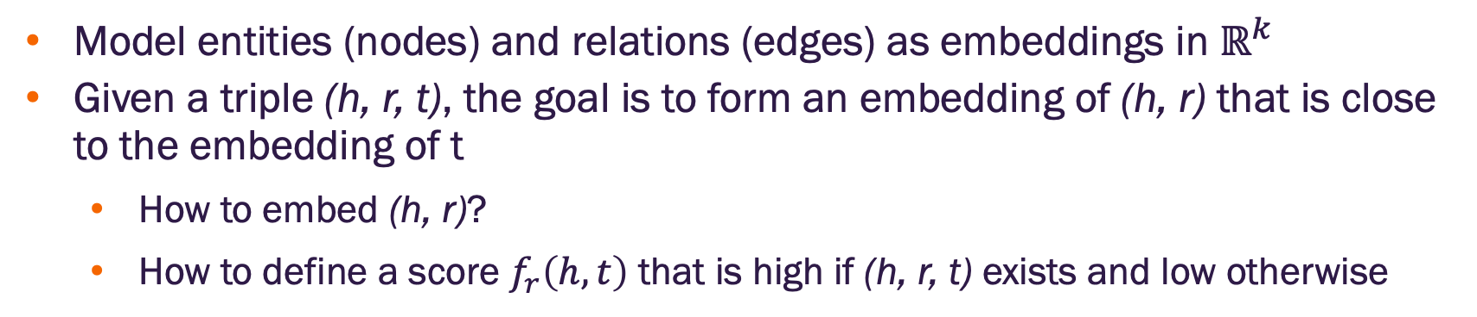
Knowledge graph (KG) completion task
Model entities (nodes) and relations (edges) as embeddings in $ℝ^{k}$
Given a triple (h, r, t), the goal is to form an embedding of (h, r) that is close to the embedding of t
How to embed (h, r)?
How to define a score $f_{r}\left(h, t\right)$ that is high if (h, r, t) exists and low otherwise
Image credit: Jure Leskovec, http://cs224w.stanford.edu

Slide 17
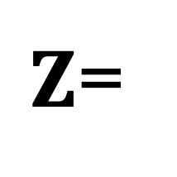
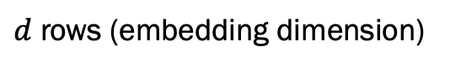
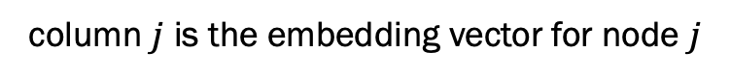
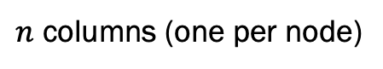
Transductive methods for KG completion
“Standard” KG completion methods use shallow embedding methods for computational efficiency on large KGs
We’ll focus on some of these that are based on different geometric intuitions
Recently (<5 years) inductive GNN methods have been developed
See https://link.springer.com/article/10.1007/s00521-023-09286-2
column $j$ is the embedding vector for node $j$
$Z$=
$d$ rows (embedding dimension)
embedding
matrix
$n$ columns (one per node)

Slide 18
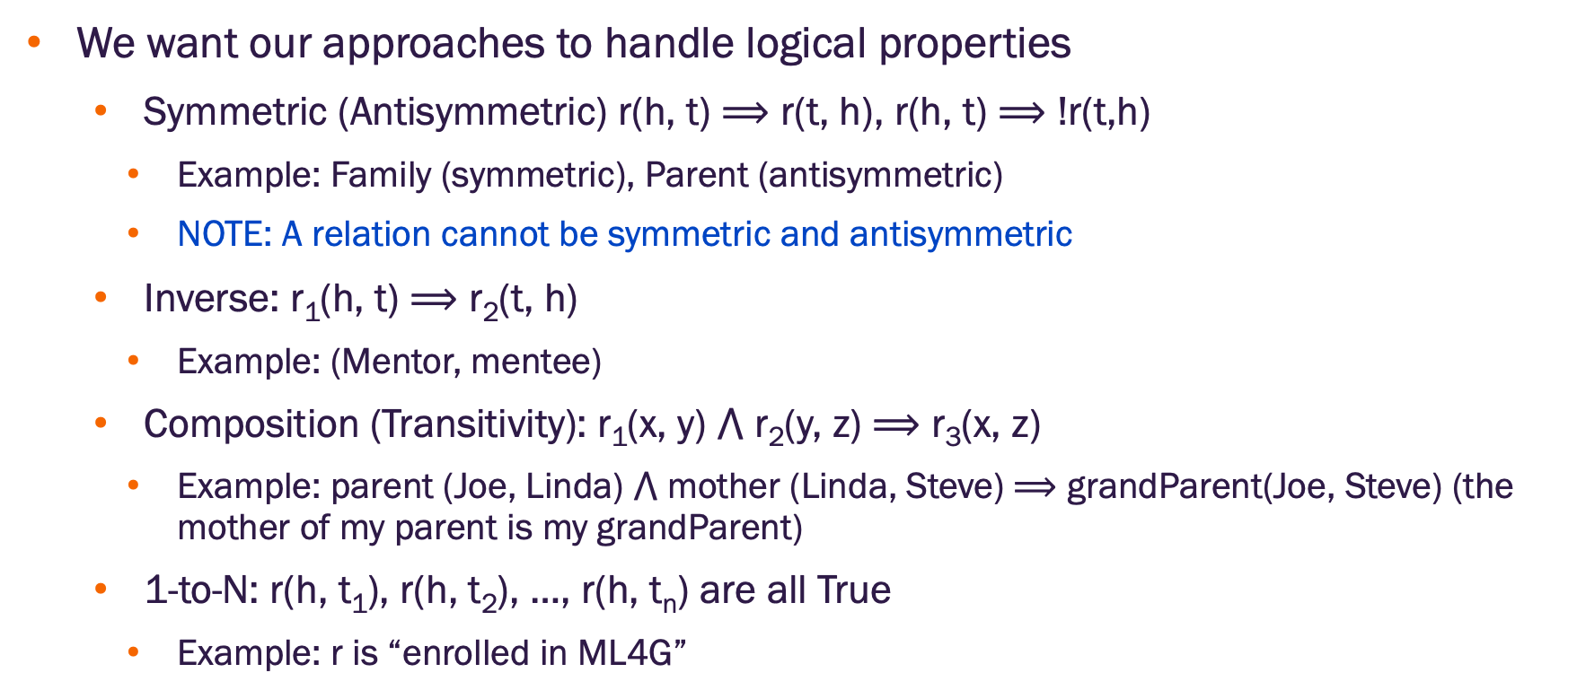
Knowledge graph (KG) completion task
We want our approaches to handle logical properties
Symmetric (Antisymmetric) r(h, t) $⟹$ r(t, h), r(h, t) $⟹$ !r(t,h)
Example: Family (symmetric), Parent (antisymmetric)
NOTE: A relation cannot be symmetric and antisymmetric
Inverse: r₁(h, t) $⟹$ r₂(t, h)
Example: (Mentor, mentee)
Composition (Transitivity): r₁(x, y) $⋀$ r₂(y, z) $⟹$ r₃(x, z)
Example: parent (Joe, Linda) $⋀$ mother (Linda, Steve) $⟹$ grandParent(Joe, Steve) (the mother of my parent is my grandParent)
1-to-N: r(h, t₁), r(h, t₂), …, r(h, t_{n}) are all True
Example: r is “enrolled in ML4G”

Slide 19
TransE method

Slide 20
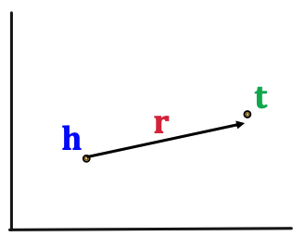
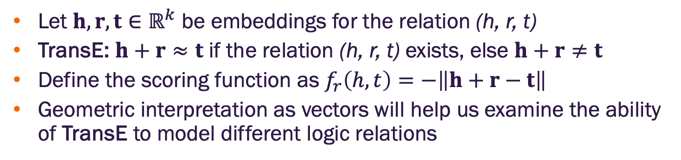
Trans(lation) Embedding (TransE)
Let $h, r, t∈ℝ^{k}$ be embeddings for the relation (h, r, t)
TransE: $h+r≈t$ if the relation (h, r, t) exists, else $h+r≠t$
Define the scoring function as $f_{r}\left(h,t\right)=−\left\|h+r−t\right\|$
Geometric interpretation as vectors will help us examine the ability of TransE to model different logic relations
Image credit: Jure Leskovec, http://cs224w.stanford.edu

Slide 21
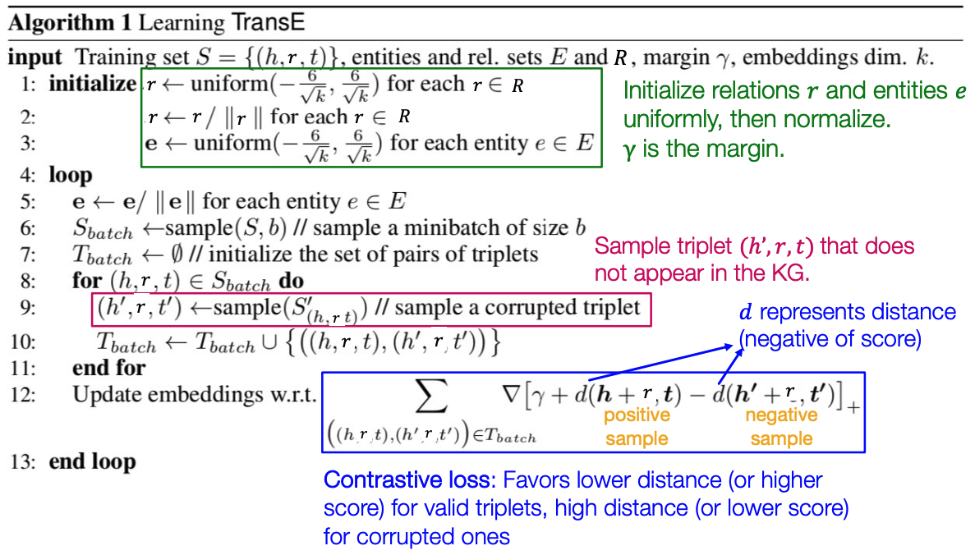
TransE learning algorithm
Image credit: Jure Leskovec, http://cs224w.stanford.edu

Slide 22
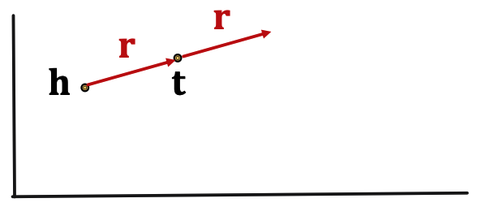
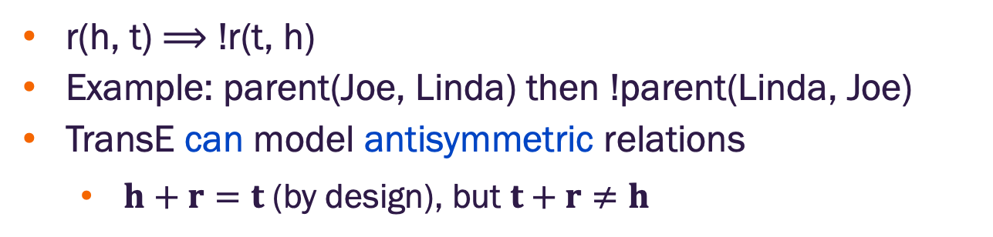
TransE antisymmetric relations
r(h, t) $⟹$ !r(t, h)
Example: parent(Joe, Linda) then !parent(Linda, Joe)
TransE can model antisymmetric relations
$h+r=t$ (by design), but $t+r≠h$
Image credit: Jure Leskovec, http://cs224w.stanford.edu

Slide 23
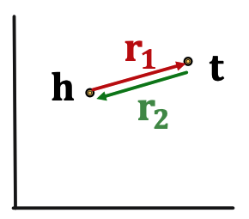
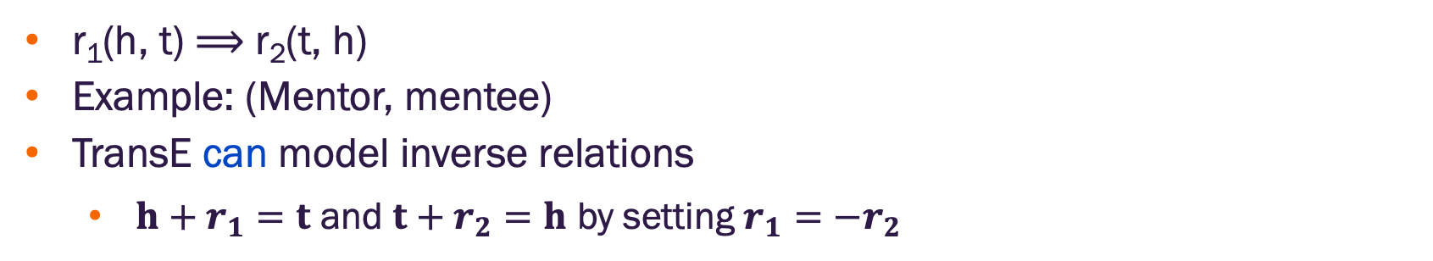
TransE inverse relations
r₁(h, t) $⟹$ r₂(t, h)
Example: (Mentor, mentee)
TransE can model inverse relations
$h+r_{1}=t$ and $t+r_{2}=h$ by setting $r_{1}=−r_{2}$
Image credit: Jure Leskovec, http://cs224w.stanford.edu

Slide 24
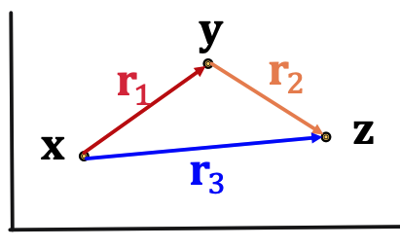
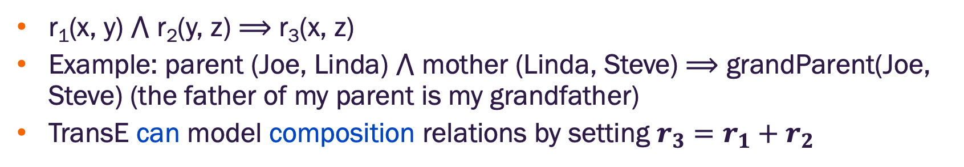
TransE composition relations
r₁(x, y) $⋀$ r₂(y, z) $⟹$ r₃(x, z)
Example: parent (Joe, Linda) $⋀$ mother (Linda, Steve) $⟹$ grandParent(Joe, Steve) (the father of my parent is my grandfather)
TransE can model composition relations by setting $r_{3}=r_{1}+r_{2}$
Image credit: Jure Leskovec, http://cs224w.stanford.edu

Slide 25
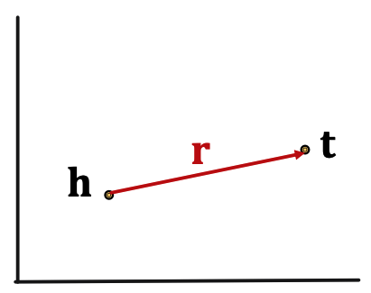
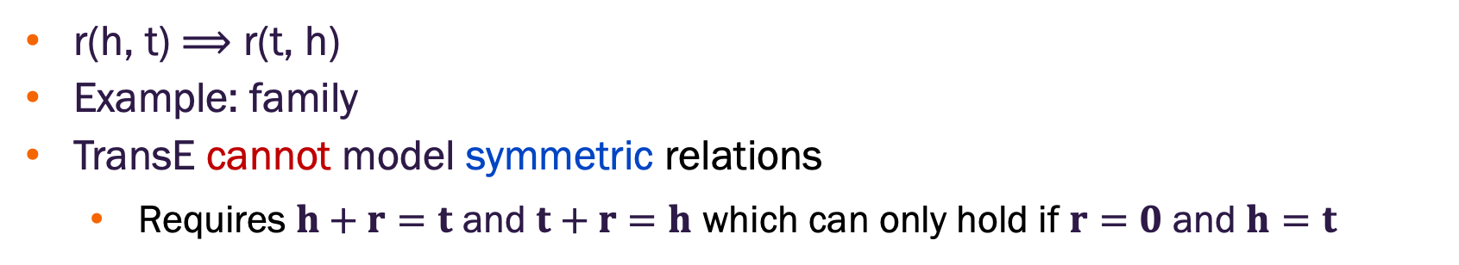
TransE symmetric relations
r(h, t) $⟹$ r(t, h)
Example: family
TransE cannot model symmetric relations
Requires $h+r=t$ and $t+r=h$ which can only hold if $r=0$ and $h=t$
Image credit: Jure Leskovec, http://cs224w.stanford.edu

Slide 26
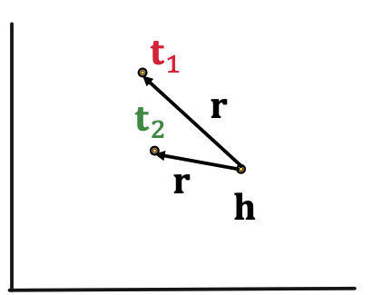
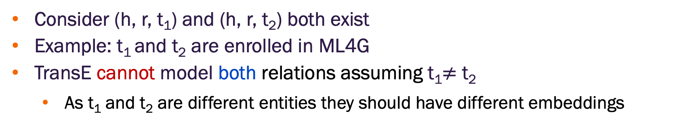
TransE 1-to-N relations
Consider (h, r, t₁) and (h, r, t₂) both exist
Example: t₁ and t₂ are enrolled in ML4G
TransE cannot model both relations assuming t₁$≠$ t₂
As t₁ and t₂ are different entities they should have different embeddings
Image credit: Jure Leskovec, http://cs224w.stanford.edu

Slide 27
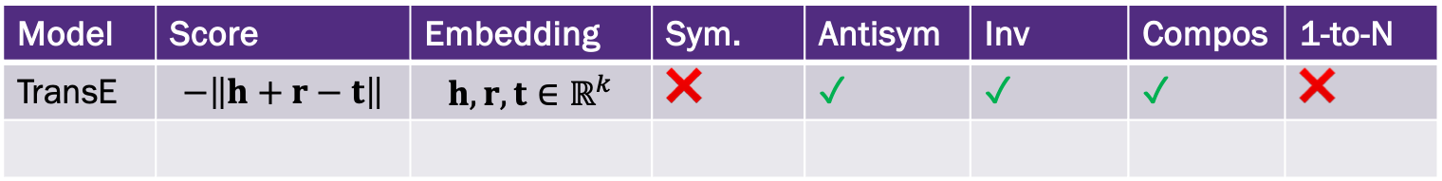
KG Completion Models
So far, we have
Model | Score | Embedding | Sym. | Antisym | Inv | Compos | 1-to-N
TransE | $$−\left\|h+r−t\right\|$$ | $$h, r, t∈ℝ^{k}$$ | ❌ | ✓ | ✓ | ✓ | ❌

Slide 28
TransR method

Slide 29
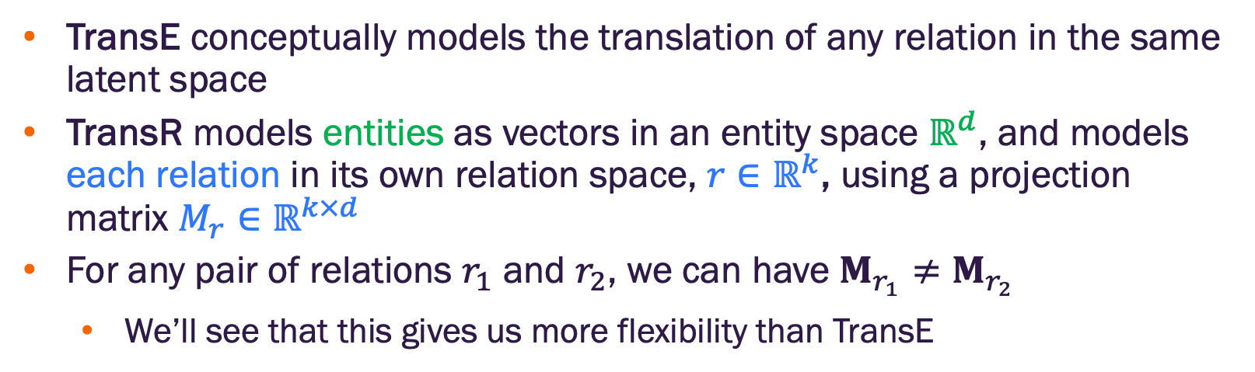
TransR
TransE conceptually models the translation of any relation in the same latent space
TransR models entities as vectors in an entity space $ℝ^{d}$, and models each relation in its own relation space, ${r∈ℝ}^{k}$, using a projection matrix $M_{r}∈ℝ^{k×d}$
For any pair of relations $r_{1}$ and $r_{2}$, we can have $M_{r_{1}}≠M_{r_{2}}$
We’ll see that this gives us more flexibility than TransE

Slide 30
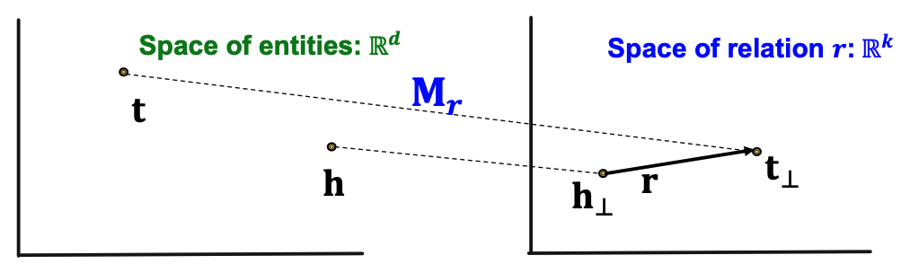
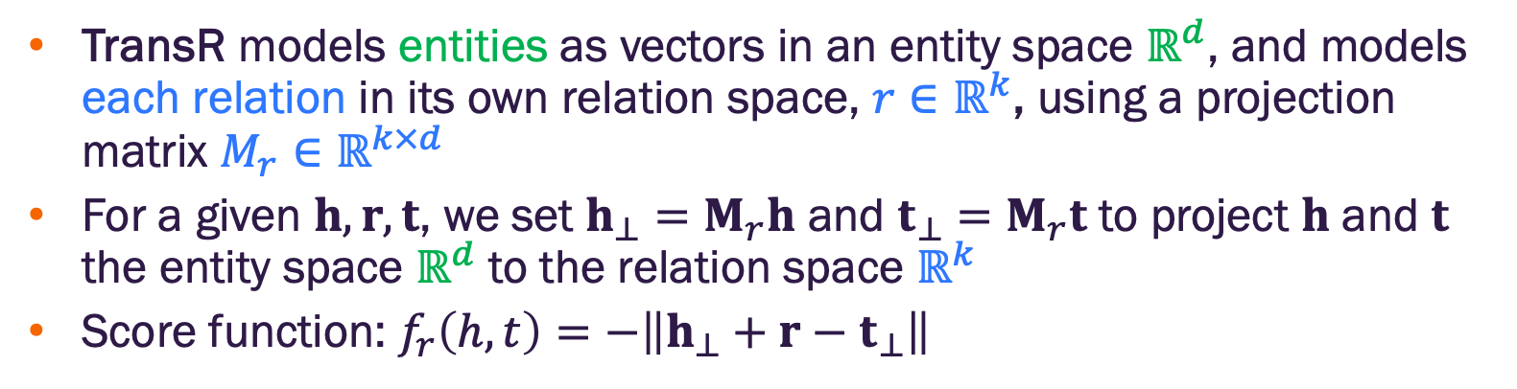
TransR
TransR models entities as vectors in an entity space $ℝ^{d}$, and models each relation in its own relation space, ${r∈ℝ}^{k}$, using a projection matrix $M_{r}∈ℝ^{k×d}$
For a given $h, r, t$, we set $h_{⊥}=M_{r}h$ and $t_{⊥}=M_{r}t$ to project $h$ and $t$ the entity space $ℝ^{d}$ to the relation space $ℝ^{k}$
Score function: $f_{r}\left(h,t\right)=−\left\|h_{⊥}+r−t_{⊥}\right\|$
Image credit: Jure Leskovec, http://cs224w.stanford.edu

Slide 31
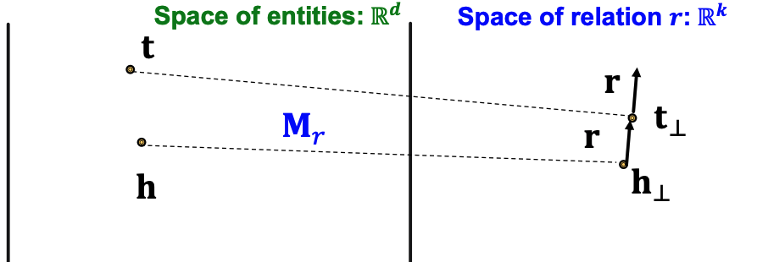
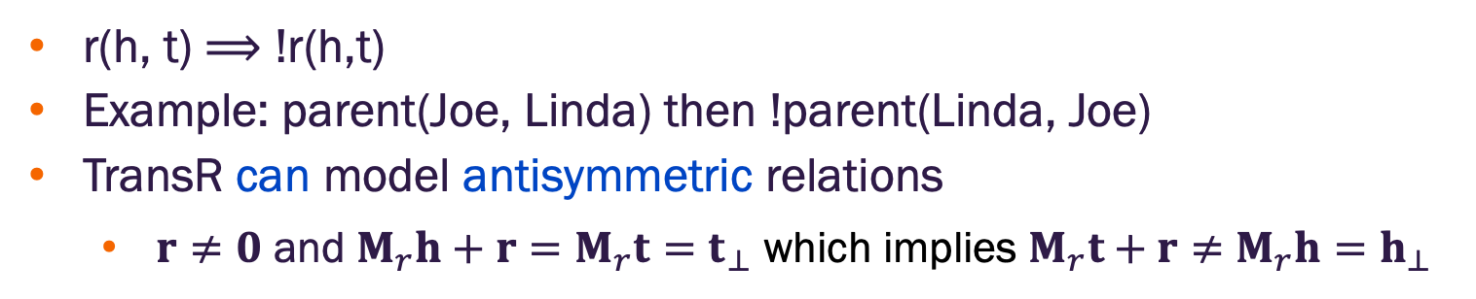
TransR antisymmetric relations
r(h, t) $⟹$ !r(h,t)
Example: parent(Joe, Linda) then !parent(Linda, Joe)
TransR can model antisymmetric relations
$r≠0$ and $M_{r}h+r=M_{r}t=t_{⊥}$ which implies $M_{r}t+r≠$ $M_{r}h=h_{⊥}$
Image credit: Jure Leskovec, http://cs224w.stanford.edu

Slide 32
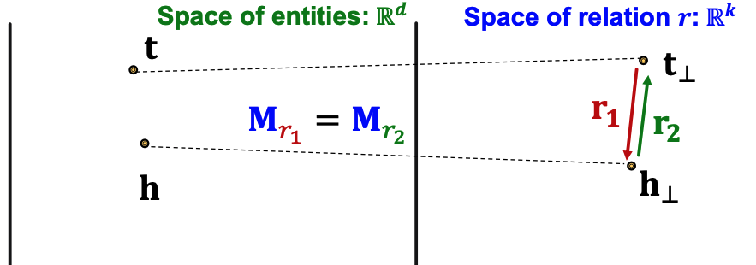
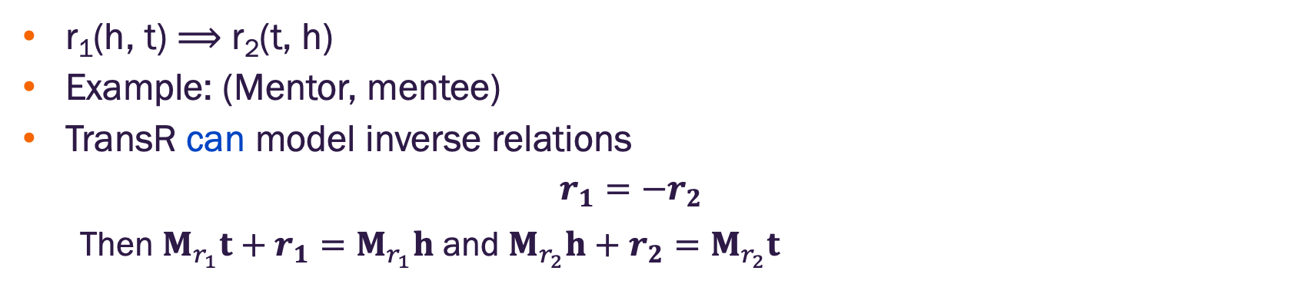
TransR inverse relations
r₁(h, t) $⟹$ r₂(t, h)
Example: (Mentor, mentee)
TransR can model inverse relations
$$r_{1}=−r_{2}$$
Then $M_{r_{1}}t+r_{1}=M_{r_{1}}h$ and $M_{r_{2}}h+r_{2}=M_{r_{2}}t$
Image credit: Jure Leskovec, http://cs224w.stanford.edu

Slide 33
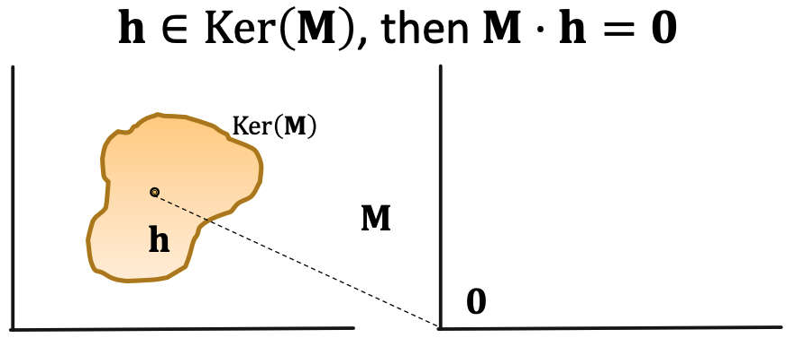
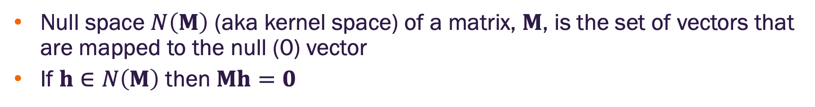
TransR and matrix null space
Null space $N\left(M\right)$ (aka kernel space) of a matrix, $M$, is the set of vectors that are mapped to the null (0) vector
If $h∈N\left(M\right)$ then $Mh=0$
Image credit: Jure Leskovec, http://cs224w.stanford.edu

Slide 34
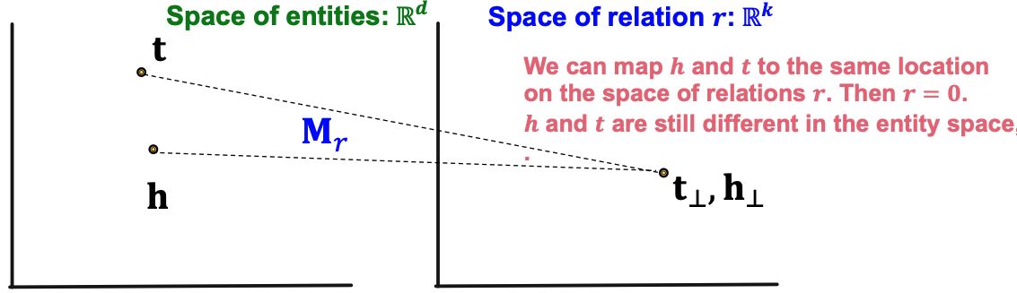
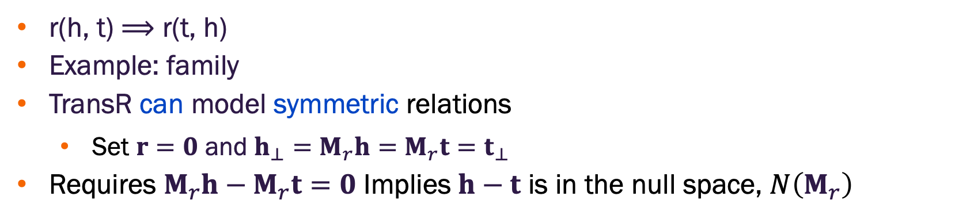
TransR symmetric relations
r(h, t) $⟹$ r(t, h)
Example: family
TransR can model symmetric relations
Set $r=0$ and $h_{⊥}=M_{r}h=M_{r}t=t_{⊥}$
Requires $M_{r}h−M_{r}t=0$ Implies $h−t$ is in the null space, $N\left(M_{r}\right)$
Image credit: Jure Leskovec, http://cs224w.stanford.edu

Slide 35
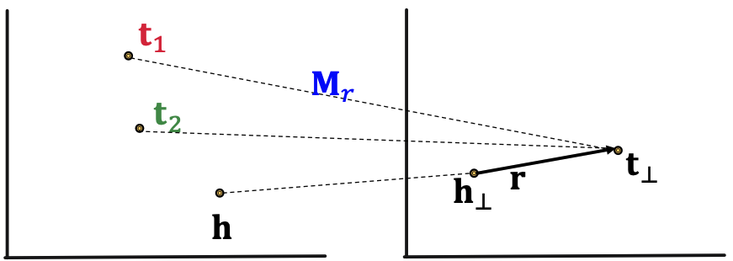
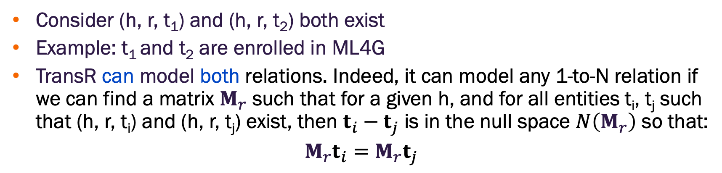
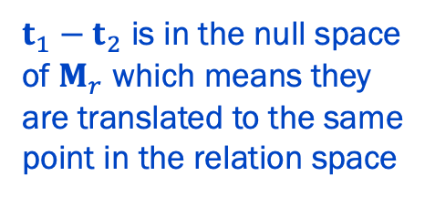
TransR 1-to-N relations
Consider (h, r, t₁) and (h, r, t₂) both exist
Example: t₁ and t₂ are enrolled in ML4G
TransR can model both relations. Indeed, it can model any 1-to-N relation if we can find a matrix $M_{r}$ such that for a given h, and for all entities t_{i}, t_{j} such that (h, r, t_{i}) and (h, r, t_{j}) exist, then $t_{i}−t_{j}$ is in the null space $N\left(M_{r}\right)$ so that:
$$M_{r}t_{i}=M_{r}t_{j}$$
$t_{1}−t_{2}$ is in the null space of $M_{r}$ which means they are translated to the same point in the relation space
Image credit: Jure Leskovec, http://cs224w.stanford.edu

Slide 36
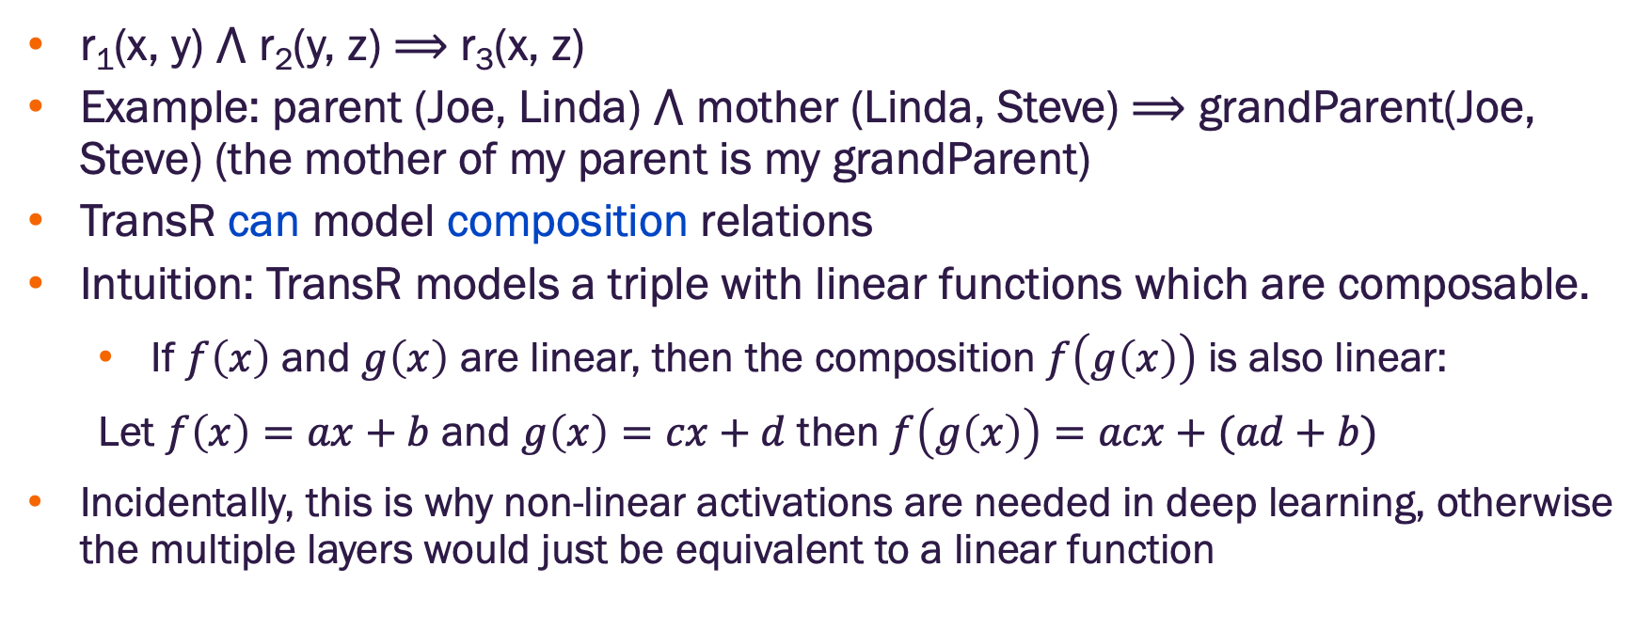
TransR composition relations
r₁(x, y) $⋀$ r₂(y, z) $⟹$ r₃(x, z)
Example: parent (Joe, Linda) $⋀$ mother (Linda, Steve) $⟹$ grandParent(Joe, Steve) (the mother of my parent is my grandParent)
TransR can model composition relations
Intuition: TransR models a triple with linear functions which are composable.
If $f\left(x\right)$ and $g\left(x\right)$ are linear, then the composition $f\left(g\left(x\right)\right)$ is also linear:
Let $f\left(x\right)=ax+b$ and $g\left(x\right)=cx+d$ then $f\left(g\left(x\right)\right)=acx+(ad+b)$
Incidentally, this is why non-linear activations are needed in deep learning, otherwise the multiple layers would just be equivalent to a linear function

Slide 37
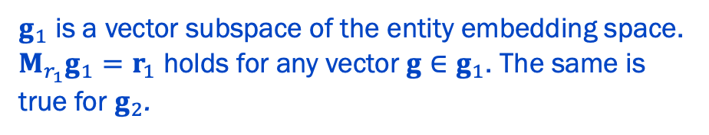
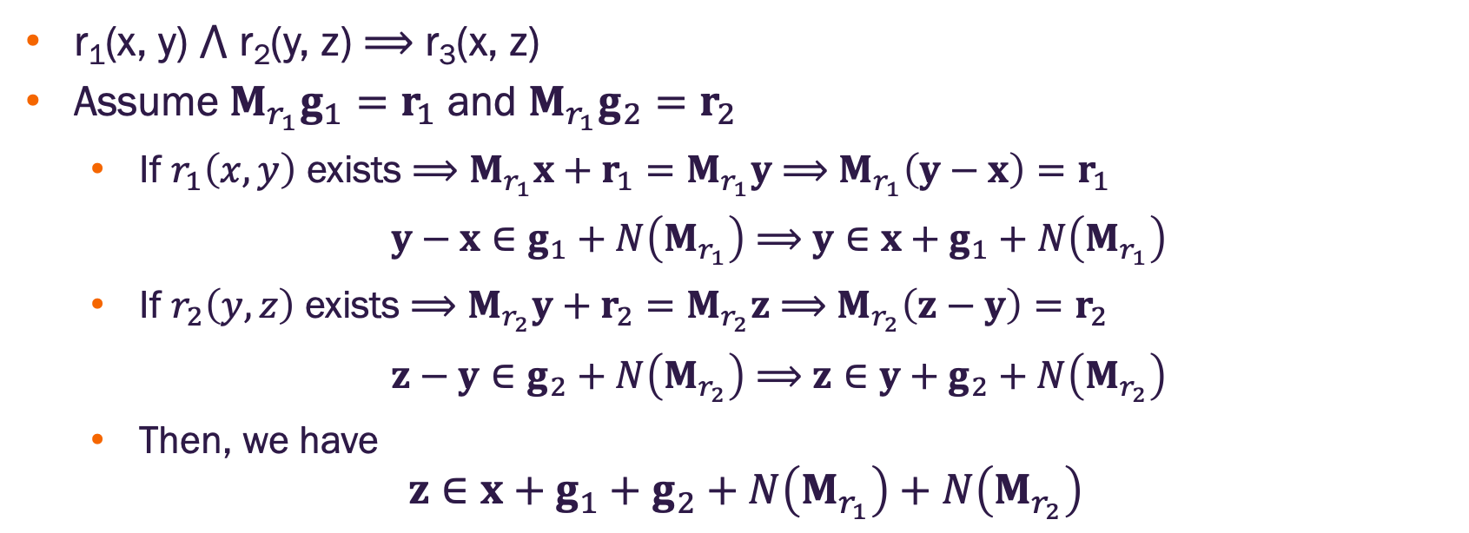
TransR composition relations
$g_{1}$ is a vector subspace of the entity embedding space. $M_{r_{1}}g_{1}=r_{1}$ holds for any vector $g∈g_{1}$. The same is true for $g_{2}$.
r₁(x, y) $⋀$ r₂(y, z) $⟹$ r₃(x, z)
Assume $M_{r_{1}}g_{1}=r_{1}$ and $M_{r_{1}}g_{2}=r_{2}$
If $r_{1}\left(x,y\right)$ exists $⟹$ $M_{r_{1}}x+r_{1}=M_{r_{1}}y$ $⟹$ $M_{r_{1}}\left(y−x\right)=r_{1}$
$y−x∈g_{1}+N\left(M_{r_{1}}\right)$ $⟹$ $y∈x+g_{1}+N\left(M_{r_{1}}\right)$
If $r_{2}\left(y,z\right)$ exists $⟹$ $M_{r_{2}}y+r_{2}=M_{r_{2}}z$ $⟹$ $M_{r_{2}}\left(z−y\right)=r_{2}$
$z−y∈g_{2}+N\left(M_{r_{2}}\right)$ $⟹$ $z∈y+g_{2}+N\left(M_{r_{2}}\right)$
Then, we have
$$z∈x+g_{1}+g_{2}+N\left(M_{r_{1}}\right)+N\left(M_{r_{2}}\right)$$

Slide 38
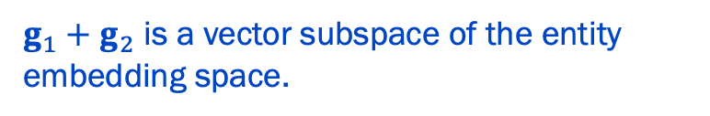
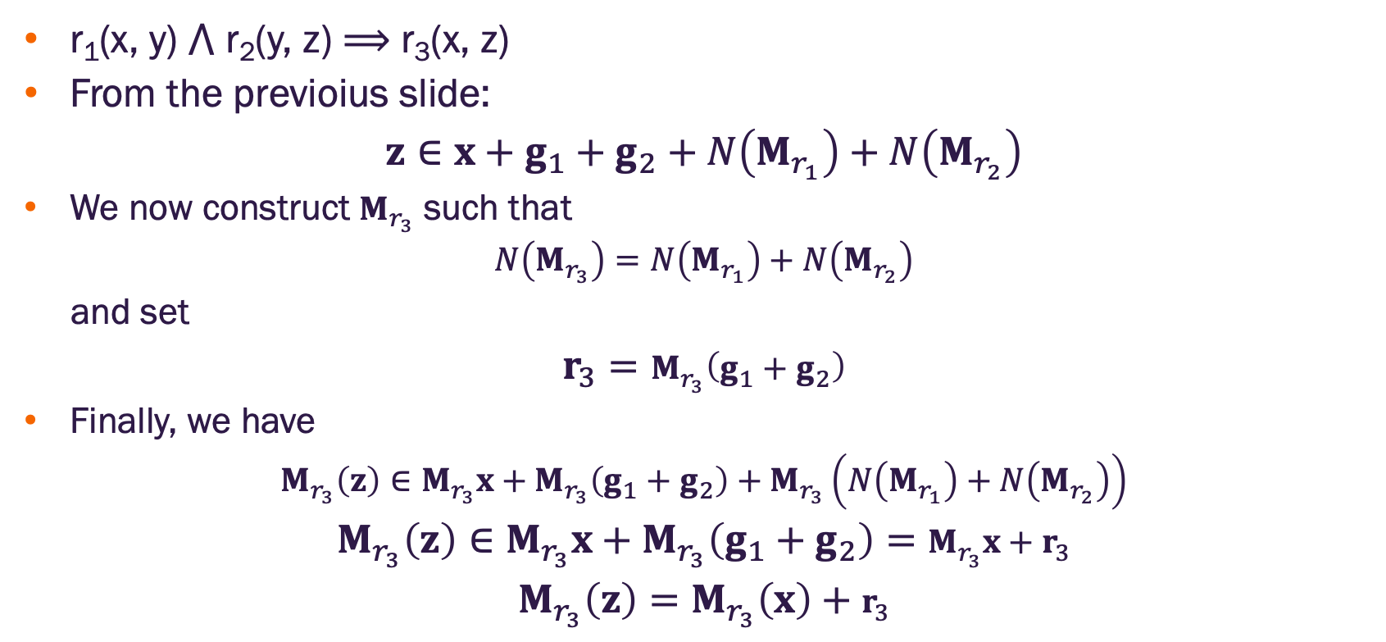
TransR composition relations
$g_{1}$ is a vector subspace of the entity embedding space. $M_{r_{1}}g_{1}=r_{1}$ holds for any vector $g∈g_{1}$. The same is true for $g_{2}$.
r₁(x, y) $⋀$ r₂(y, z) $⟹$ r₃(x, z)
From the previoius slide:
$$z∈x+g_{1}+g_{2}+N\left(M_{r_{1}}\right)+N\left(M_{r_{2}}\right)$$
We now construct $M_{r_{3}}$ such that
$$N\left(M_{r_{3}}\right)=N\left(M_{r_{1}}\right)+N\left(M_{r_{2}}\right)$$
and set
$$r_{3}=M_{r_{3}}\left(g_{1}+g_{2}\right)$$
Finally, we have
$$M_{r_{3}}\left(z\right)∈M_{r_{3}}x+M_{r_{3}}\left(g_{1}+g_{2}\right)+M_{r_{3}}\left(N\left(M_{r_{1}}\right)+N\left(M_{r_{2}}\right)\right)$$
$$M_{r_{3}}\left(z\right)∈M_{r_{3}}x+M_{r_{3}}\left(g_{1}+g_{2}\right)=M_{r_{3}}x+r_{3}$$
$${M_{r_{3}}\left(z\right)=M}_{r_{3}}\left(x\right)+r_{3}$$
$g_{1}+g_{2}$ is a vector subspace of the entity embedding space.
necessarily a null vector

Slide 39
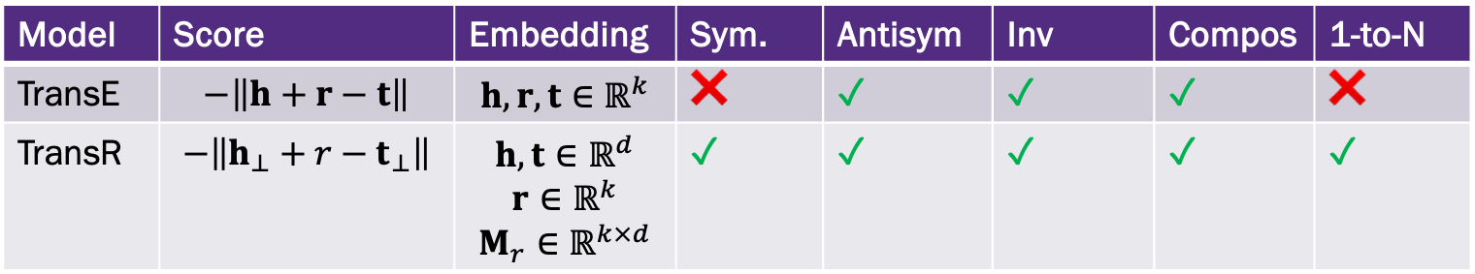
KG Completion Models
Model | Score | Embedding | Sym. | Antisym | Inv | Compos | 1-to-N
TransE | $$−\left\|h+r−t\right\|$$ | $$h, r, t∈ℝ^{k}$$ | ❌ | ✓ | ✓ | ✓ | ❌
TransR | $$−\left\|h_{⊥}+r−t_{⊥}\right\|$$ | $$h, t∈ℝ^{d}$$ $$r∈ℝ^{k}$$ $$M_{r}∈ℝ^{k×d}$$ | ✓ | ✓ | ✓ | ✓ | ✓

Slide 40
KG completion in practice
There are numerous other methods for KG completion
Different KGs may have drastically different relation patterns
There is not a general method (yet) that works for all KGs
Try TransE for a quick analysis
Then use more complex (TransR, ComplEX, RotateE, …)

Slide 41


